Slide 1
Request for Permissions & Service Agreement
May 2025

Slide 2
Request for Permissions – Why?
Required by Canon Law
The Bishop desires be aware of certain activities
Required by our Insurance

Slide 3
Request for Permissions - Purpose
While the pastor, canonical administrator of parish or school, or other appropriated delegated church official has the authority to take actions (within the boundaries of corporate governance), certain actions require diocesan review and canonical permission by the Bishop or his delegate for the sake of canonical (or even civil) validity.
The purpose of this policy is to articulate expectations for these particular actions. This permission is sometimes canonically required by an action itself, and at other times, it is required because a certain action has been identified as “an act of extraordinary administration” by the diocesan bishop (c. 1281 §§1-2).

Slide 4
Request for Permissions – Why New Process
Clarify what actions that require Diocesan Approval
Try to make the process straight-forward and efficient
Document the flow and confirm approval

Slide 5
Activities that Require Canonical Permission
Purchase of Real Property
Any Borrowing or Entering into a Lin of Credit
Leasing Property to a non-Diocesan Entity
Alienation of religious artifacts considered part of religious patrimony (i.e. artifacts of significance to the devotional or liturgical life of the entity)
One-time commitment of resources, purchased or leased, over $50,000, outside the operational budget
Building projects (construction, renovation, extraordinary repairs)
Alienation of real property
Initiating or responding to civil litigation (c.1288)
Capital Campaigns
Refusing and accepting major gifts (c. 1267 §§1-2)

Slide 6
Purchase of Real Property
All proposed purchases must be reviewed by the Chief Finance Officer of the Diocese and receive canonical permission from the Bishop.
Purchases of $250,000 or greater require approval from the diocesan College of Consultors and the diocesan Finance Council prior to canonical review and permission by the Bishop.

Slide 7
Any borrowing or entering into a line of Credit
All proposed purchases must be reviewed by the Chief Finance Officer of the Diocese and receive canonical permission from the Bishop.
May require additional action if it may potentially threaten the “stable patrimony” of the organization, requires approval by the diocesan College of Consultors and Finance Council (cf. c. 1295).

Slide 8
Leasing property to a non-diocesan entity
Written notice of any proposed lease of property to a non-diocesan entity, regardless of value shall be provided to the diocesan Chief Financial Officer.
If the total of all lease payments or the value of the property subject to the lease is $25,000 or more, or if the lease lasts longer than a year, in compliance with the USCCB Complementary Norm on Canon 1297, canonical permission from the Bishop is required.

Slide 9
Alienation of religious artifacts considered part of religious patrimony (i.e. artifacts of significance to the devotional or liturgical life of the entity)
Alienation of any religious artifacts considered part of religious patrimony of the organization must be reviewed by the diocesan Chief Financial Officer and diocesan Vicar for Worship and receive canonical permission from the Bishop.
In compliance with the USCCB Complementary Norm on Canon 1292, §1, for alienation of religious artifacts valued above $25,000 or 10% of the entity’s prior year ordinary annual income, whichever is higher, the Bishop is to receive consent from the diocesan College of Consultors and diocesan Finance Council prior to providing canonical permission.

Slide 10
Definition of Religious Artifacts
All items that serve a recognizable liturgical or devotional function, such as religious art, statues, books, or vestments

Slide 11
One-time commitment of resources, purchased or leased, over $50,000, outside the operational budget
All proposed purchases must be reviewed by the Chief Finance Officer of the Diocese and receive canonical permission from the Bishop.
Purchases of $250,000 or greater require approval from the diocesan College of Consultors and the diocesan Finance Council prior to canonical review and permission by the Bishop.

Slide 12
Building projects (construction, renovation, extraordinary repairs)
All proposed building projects for parish churches or chapels [or related to liturgical questions] require diocesan review by the Vicar for Worship and canonical permission from the Bishop.
Projects above $50,000 require diocesan review facilitated by the Director of Property Management.
Projects above $100,000 require review by the Building Commission.
Building projects involving repairing damage (i.e. storms) may not require Building Commission review, but the plan and contract(s) are to be reviewed by the Director of Property Management.

Slide 13
Alienation of Real Property
Any alienation of real property must be reviewed by the diocesan Chief Finance Officer and receive canonical permission from the Bishop.
In compliance with the USCCB Complementary Norm on Canon 1292, §1, alienation of real property above $25,000 or 10% of the entity’s prior year ordinary annual income, whichever is higher, requires the Bishop to receive consent from the diocesan College of Consultors and diocesan Finance Council prior to providing canonical permission.

Slide 14
Initiating or responding to civil litigation (c.1288)
Civil litigation may not be initiated without diocesan review and receiving canonical permission from the Bishop.
All lawsuits, complaints, subpoenas, or other notices of legal proceedings or governmental regulatory or administrative action which requires a responsive legal pleading or other action by the organization are to be immediately reported to the Diocesan Director of Human Resources, diocesan Chief Financial Officer, and Chancellor.

Slide 15
Capital Campaigns
In compliance with the USCCB Complementary Norm on Canon 1262, all proposed capital campaigns need to receive canonical permission from the Bishop. Prior to this permission being provided, proposed campaigns must be reviewed by the diocesan Director of Development and Chief Finance Officer.
Any campaign involving the purchase of real property and/or building projects, shall also be subject to the approval requirements applicable to building projects and or real property purchases, set forth above under this Canonical Permissions Policy.

Slide 16
Refusing and accepting major gifts (c. 1267 §§1-2)
The rejection of gifts valued at over $100,000, or acceptance of gifts when the gift includes additional conditions such as naming rights or other conditions governing use of the gift beyond the designated purpose, require canonical permission from the Bishop.

Slide 17
Who does this apply to?
This policy can apply to organizations directly, because of their identity as public juridic persons (e.g. parishes); derivatively, because they are apostolates of public juridic persons (e.g. parish schools and parish foundations), or particularly because the diocesan bishop has identified a specific apostolate as benefiting from the policy (e.g. Emmaus House, Other Diocesan schools (Dowling College, St Albert’s etc.).

Slide 18
Other Definitions
Alienation: The transfer of ownership of property (real or personal) from one person (physical or juridic) to another. When the property is of a certain value and/or type (e.g. stable patrimony or historically or artistically precious items), it must be alienated according to certain canonical formalities. These formalities are described as “restricted alienation.”
Stable Patrimony: all property (real or personal) which is intended to remain in the possession of the owner for a long or indefinite period of time. When stable patrimony of a particular value is alienated or when another action could worsen/jeopardize the stable patrimony, it requires certain canonical formalities which are meant to ensure transparent and effective administration of goods.
Any action that may potentially threaten the “stable patrimony” of the organization, requires approval by the diocesan College of Consultors and Finance Council (cf. c. 1295).

Slide 19
Other Permissions – Required by Insurance
Employee Terminations: All employee terminations are required to be reviewed and approved by the Director of HR & Safe Environment. Employment practices insurance may not cover employee claims for wrongful termination.
Contract Reviews: All building related contracts (even if they are related to insurance claim repairs) are required to be reviewed by the Director of Property Management. Non-building related contracts should be reviewed by Catholic Mutual.

Slide 20
Requestion for Permissions – Process
Forms for each Approval will be on the Diocesan Finance Website
Fillable Forms
Identify Required Documents
Submit Button
After Submission – Confirmation Email will be sent from Requests@dmdiocese.org
All requests will be monitored to a insure timely response on the Diocese side.
All completed requests will be filed at the Diocese.

Slide 21
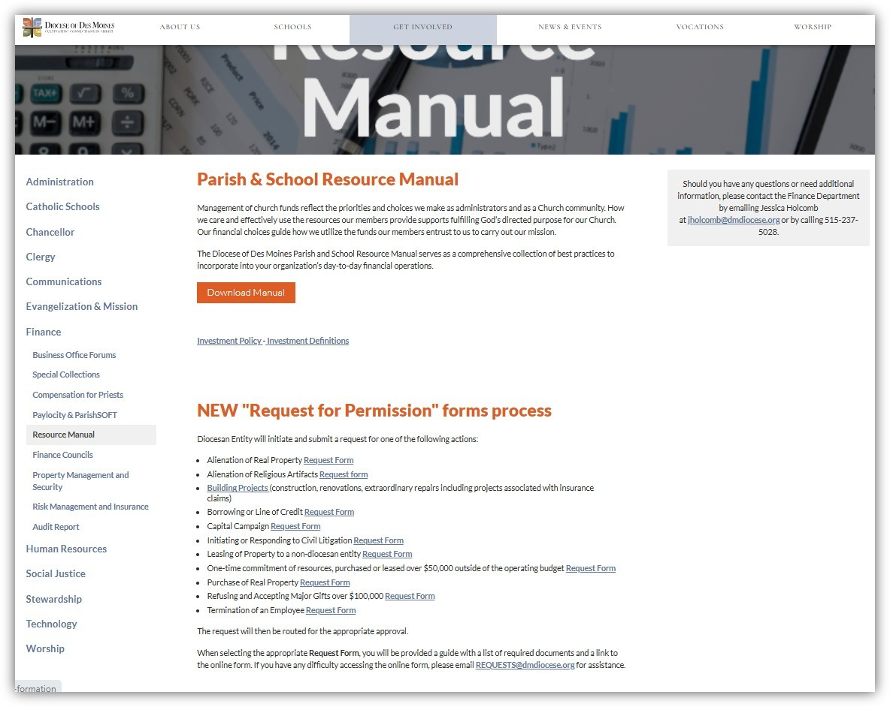
Request for Permissions – New Process

Slide 22
Diocese Service Agreement
Purpose:
Strengthen the document that we are all separate legal entities doing business independently but still under Canon Law.
Identify common services performed for the affiliate by the Diocese
Identify specific services performed for specific affiliates of the Diocese

Slide 23
Diocese Service Agreement
Common Services (Paid via ADA – IT WILL BE NETTED - NO ADDITIONAL CHARGES):
Human Resources
Safe Environment
Finance
Insurance & Risk Management
Property Services
Development Services
Legal Matters
Information Technology & Other Business Services
Pastoral Services
Schools Related Services

Slide 24
Diocese Service Agreement
Specific Services (Services to be billed separately):
Payroll
Accounting
IT Support

Slide 25
Diocese Service Agreement
Timing:
Sending out to Business Managers and Pastors in June
Would hope to gather Pastor’s signatures before July 1st.
Effective 1 July 2025

Slide 26
Insurance Renewal
Property Coverage - Increase 10 -11%
Liability Coverage – Increase 8%
Worker’s Compensation – 10.5%

